Slide 1
Rally Health Eligibility Canonical Update
Team Mackers
Notes:
Tony

Slide 2




Introduction
Tony Cai
University of Minnesota
Kristen Hawken
Iowa State
Naren Nandyal
University of Minnesota
Mason Schmidt
Pensacola Christian College
Notes:
Standard Assets Engineering Operations
"We partner with Optum data producers and consumers, along with Enterprise Data Architects, to design and implement standard data stores that make the most critical Optum data available to all parts of the business in a common, well understood form.”

Slide 3


Background
Rally Health
V2 – Old way of constructing canonical streams
Lots of custom coding
Uses obsolete technologies
V3 – Current way of constructing canonical streams
Uses the capabilities of EBaaS (Entity Builder as a Service)
Takes advantage of modern technologies
Notes:
Tony
Rally Health is a digital health platform that provides reward programs for customers of uhg, who’s eligibilities are checked through the database
V2 currently not optimal, which will be shown later
EBaaS: “EBaaS is a tool to reliably denormalize and canonicalize large relational datasets in real time. EBaaS is a platform offering that provides fast, scalable resilient data streaming into the Health Care Platform at a significantly reduced cost than doing so independently.”
Canonical Data is beneficial because it allows data to be shared in the simplest form and allows for a common language to manage the data. It allows for smoother integration.

Slide 4

Problem Statement
Why this is a problem:
High Risk – Knowledge and support is limited
High Cost – Depends on obsolete and expensive software and infrastructure
Lack of Standardization
On September 9, 2022, Rally Health will be the last consumer of V2 streams
Rally Health cannot commit to moving off V2 until early 2023
Rally Health currently receives eligibility data in the legacy V2 canonical stream.
Notes:
Naren
Rally Health is currently using the legacy V2 canonical stream, and we want to shift them to the current standard V3 stream. They are soon to be the last consumer of V2 streams, but they are hesitant to change the way that things work currently. So, we have to show them the benefits of converting to V3 and also create a smooth transition from V2 to V3.
High Risk:
-Knowledge and support for v2 stream techniques and tech is limited
-Outage where nobody knew how to fix because people did not understand V2.
-an outage can cost up to $400k an hour for a company during an outage.
High Cost:
-Depends on out of date and costly software and infrastructure.

Slide 5
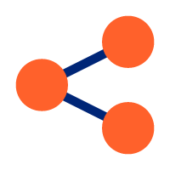


Solution
Engineer a new canonical stream
Use same Rally Schema to simplify transition
Connect Rally schema to V3 schema
V2
infrastructure decommissioned
greatly reduced
$250-300k
average savings each month
Risk
Notes:
Kristen
The solution is to engineer a new canonical stream based on the current V3 tech stack and techniques. The reason they can't commit until 2023 is because they don't see this as high priority, as nothing will change on their end, but it's important to us in order to cut costs and reduce risk. Rally will use the same schema, but will connect to our V3 schema instead of our V2 schema. This switch is only on our end, as their messages will still read in the same format on their end. This way we can transfer them over to the V3 canonical stream in a way that makes the transition seamless for them.
Save 250-300k a month, with no one left using it finally end and decommission V2 infrastructure, reduce risk like Naren said about outage it takes a long to time to figure out how to fix it or even notice it

Slide 6



Tech Stack
GoLang
To program
Kafka
To send/receive data from canonical streams
Docker
To ship the application
GCP/Azure
To host Kubernetes
Kubernetes
To run on top of cloud
(Kafka)
Notes:
Naren
GoLang: the programming language we will use to implement and use EBaaS (entity builder as a service), allowing us to convert to V3 because V3 implements EBaaS.
Kafka: Kafka is an event-streaming platform, used for pipelining data. Kafka will be used to send and receive data from canonical streams
Docker: will be used to publish the application for transport and make it compatible across any system.
Azure/GCP: A cloud platform, such as Azure or Google Cloud Platform, which we can use to host Kubernetes
Kubernetes: This is an open-source system for managing containers. So, this will run on top of cloud and allow us to manage our Docker containers

Slide 7
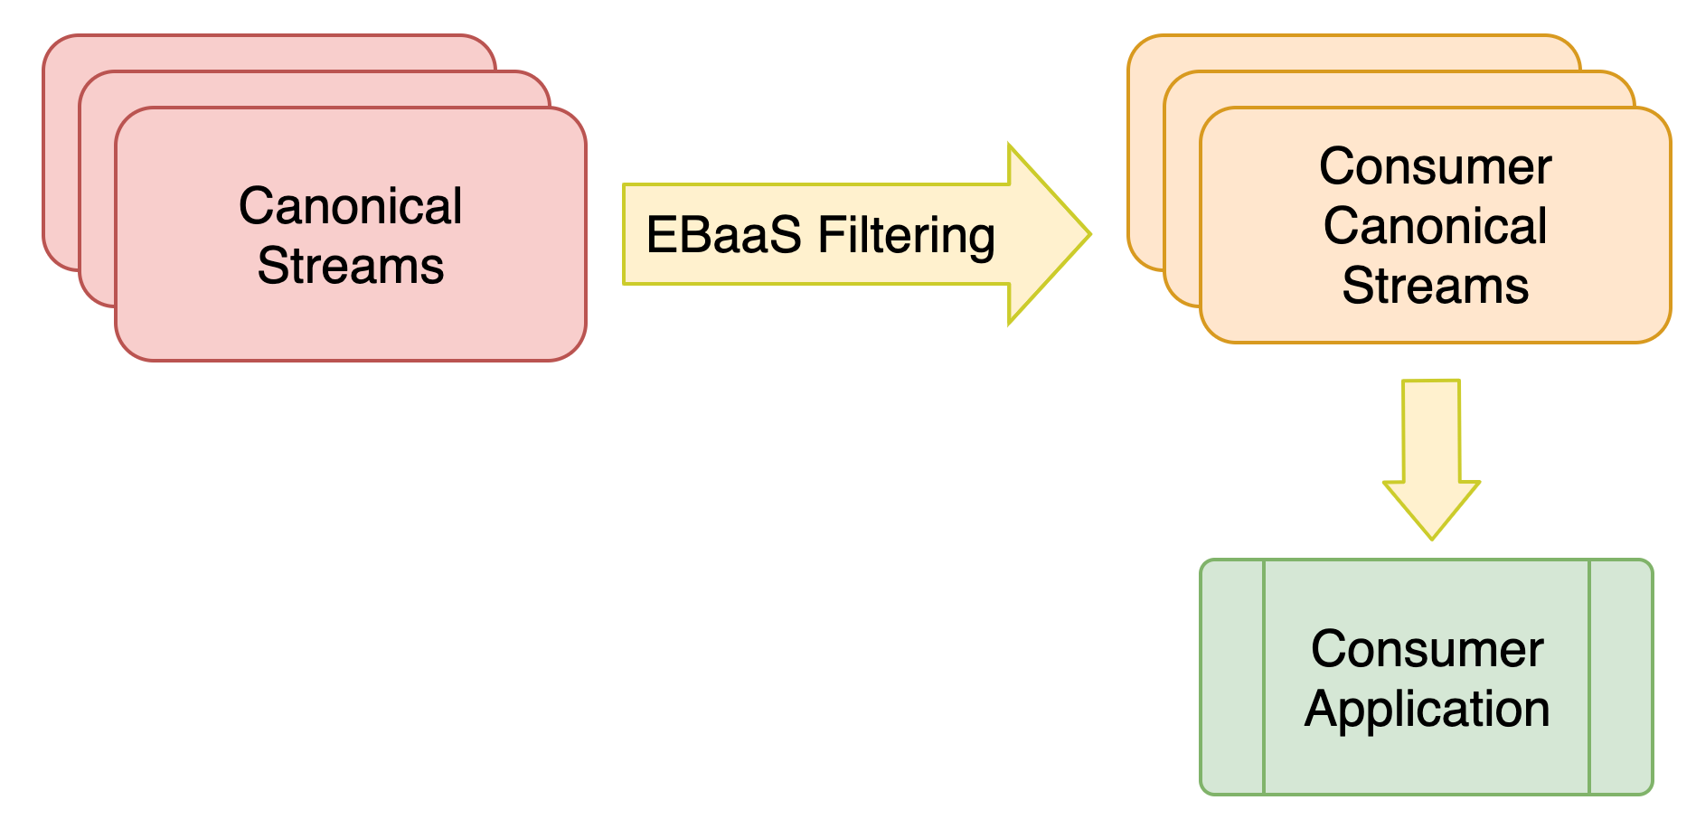
Standard Streams Data Flow
EBaaS = Entity Builder as a Service
Notes:
Mason
A canonical stream is basically a way of interpreting data. In this case, health data. So we transfer it from a way that we interpret the health data, to a way that rally health does.
We are taking the old canonical streams and filtering them with EBaaS to make consumer canonical streams. What this means is that Rally health gets the new canonical streams without needing to know all of the background things happening. So, they get the new, filtered streams for their application.
And the way this EBaaS filtering is done, is in this next slide.

Slide 8
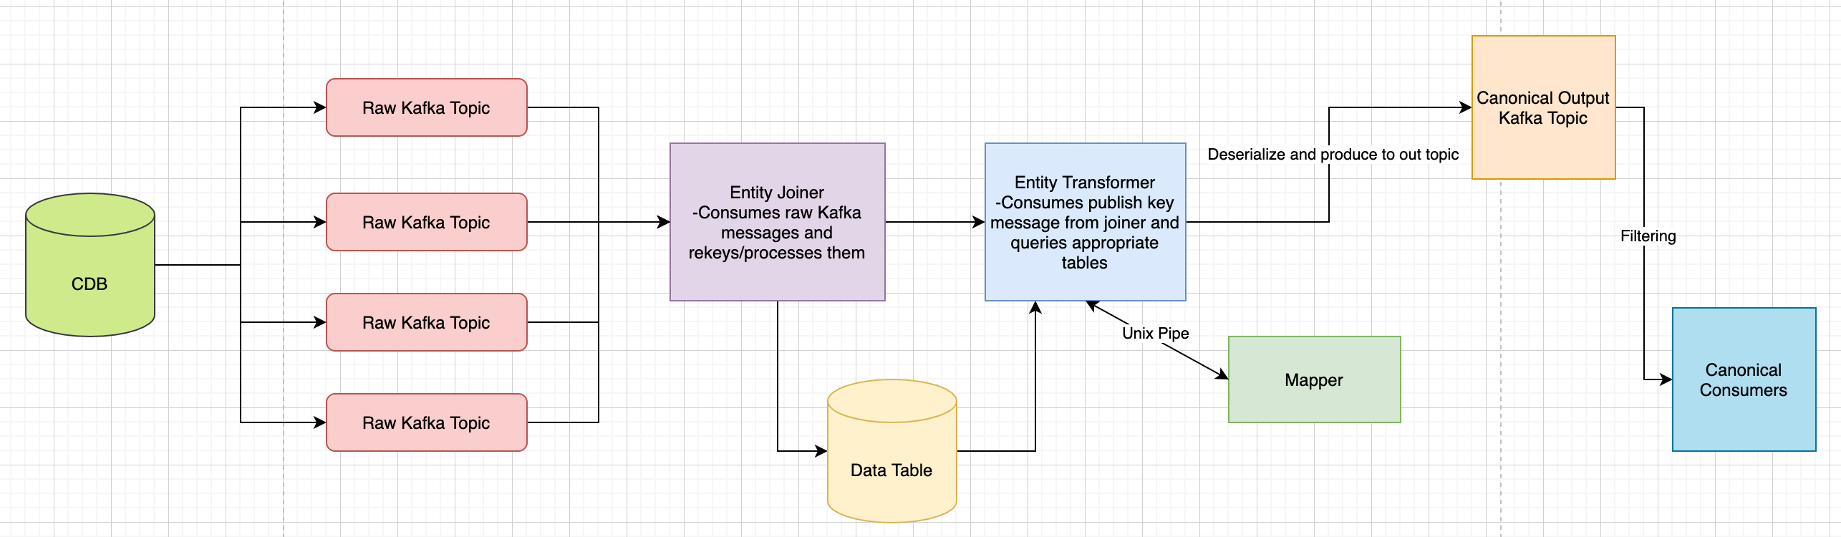
Entity Builder as a Service Filtering
Notes:
Mason
CDC kafka topics
Unix pipes
Change data base gets changed health information
" An Entity-Builder is a way of taking many tables in a source system, joining the data on a configurable key, mapping to a canonicalized view of the entity and finally producing to a compacted Kafka output topic”
So essentially, it’s a way of organizing a lot of information. You start with the raw topics which is just different health information. Then join them all together. Next, you further organize them by using the mapper, which associates a key with a value. So, for instance let’s say you have information about someone. Their name, phone number, and email. So, each characteristic would be its own raw topic. Then you would join it together, map it, and produce a compact organized topic with all of the information together. So, this information is what Rally Health would then use in their application.

Slide 9
Current Progress
Simple Local Data Pipeline Practice Project
Producer
Consumer
Kafka Broker
Serialize with Schema
Deserialize with Schema
Notes:
Tony
This is our practice project that implements the technologies that we will be using in our real project.
Producer: Sends the message.
Kafka Broker: Picks the correct message
Consumer: Gets the message from the producer
Serialize with schema so only certain data can pass through.
Deserialize with schema to interpret the serialized message.
Next steps
Learn and utilize ebaas filtering so that v3 can be used to replace v2 for rally health standardization

Slide 10


Conclusion
Update Rally Health from V2 canonical streams to V3
V2
V3
Rally Health
Notes:
Kristen
In conclusion our project is updating Rally Health from V2 canonical streams to V3, therefore reducing cost and risk for us without Rally Health noticing a difference.
Consume same message, feel no effects. Not impacting consumer

Slide 11
Kafka Logo: https://commons.wikimedia.org/wiki/File:Apache_kafka-icon.svg
GoLang Logo: https://en.wikipedia.org/wiki/Go_%28programming_language%29
Docker Logo: https://www.docker.com/company/newsroom/media-resources/

